Slide 1
Node JS – Custom Modules
S.Karthiga,
Assistant Professor,
Department of IT, TCE.

Slide 2
Session Outcomes
At the end of this session, students will be able to,
Create a custom module for the given problem

Slide 3
Modules
Modules are the collection of JavaScript codes in a separate logical file that can be used in external applications on the basis of their related functionality. Modules are popular as they are easy to use and are reusable.
To create a module in Node.js, you will need the exports keyword. This keyword tells Node.js that the function can be used outside the module.

Slide 4
Custom Module
The module parameter (rather a keyword in a module in Node) refers to the object representing the current module.
exports is a key of the module object, the corresponding value of which is an object.
The default value of module.exports object is {} (empty object).

Slide 5
Syntax
module.exports = name
module.exports.property = name
module.exports.function_name = function
module.exports = class
module.exports = {class1,class2};
exports.property = name
exports.function_name = function

Slide 6
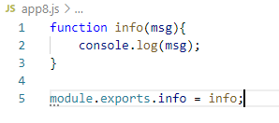
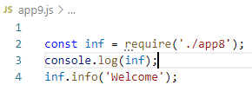

Custom Module – function

Slide 7
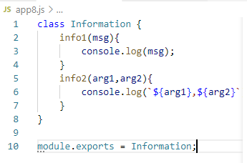
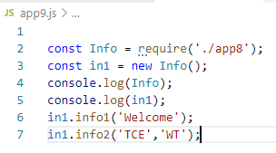
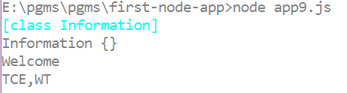
Custom Module - class

Slide 8
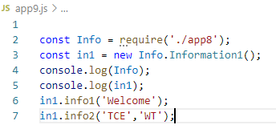
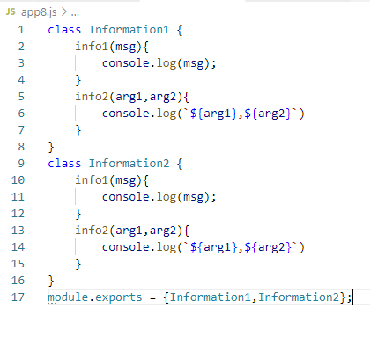
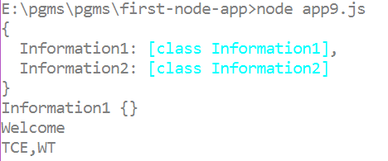
Custom Module – multiple items

Slide 9
Book1.js
const favoriteAuthor = { name: "Ken Bruen", genre: "Noir", nationality: "Irish" };
function favoriteBook() {
return { title: "The Guards", author: "Ken Bruen" };
}
function getBookRecommendations() {
return [
{id: 1, title: "The Guards", author: "Ken Bruen"},
{id: 2, title: "The Stand", author: "Steven King"},
{id: 3, title: "The Postman Always Rings Twice", author: "James M. Cain"}
];
}

Slide 10
Book2.js
const inf=require('./book1');
console.log(inf);
console.log(inf.favoriteBook());
console.log(inf.getBookRecommendations());

Slide 11
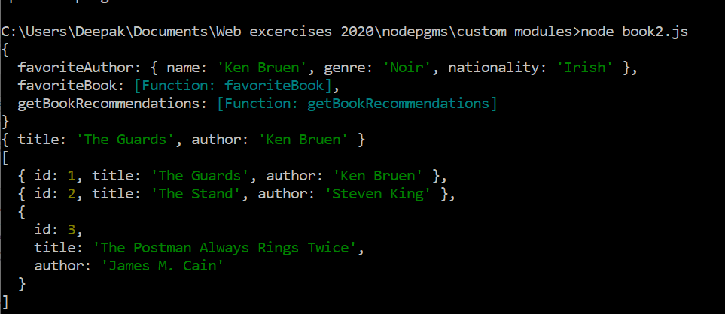
output

Slide 12
Demo

